Slide 1
第五节：Ollama生态概览
2024.8.13

Slide 2
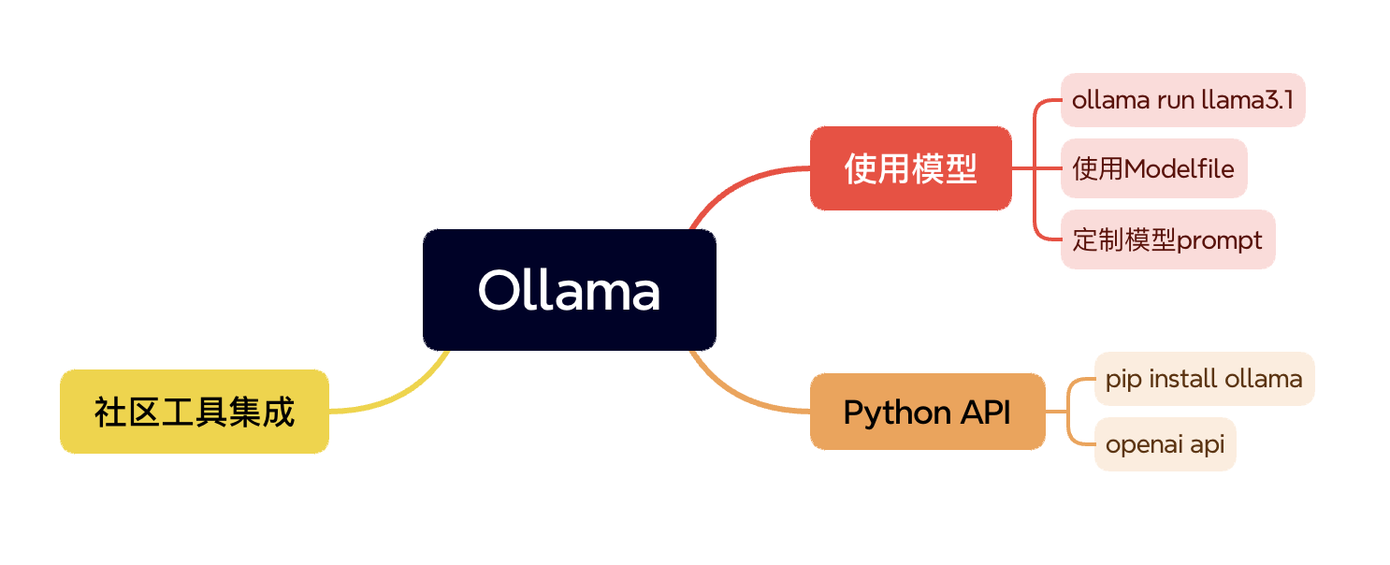
GLM4相关工具链

Slide 3
Ollama模型使用
基本用法
ollama run llama3.1
导入自己的模型
https://github.com/ollama/ollama/blob/main/docs/import.md
关于gguf文件
https://huggingface.co/docs/hub/en/gguf
https://github.com/ggerganov/ggml/blob/master/docs/gguf.md
编写Modelfile
https://github.com/ollama/ollama/blob/main/docs/modelfile.md

Slide 5
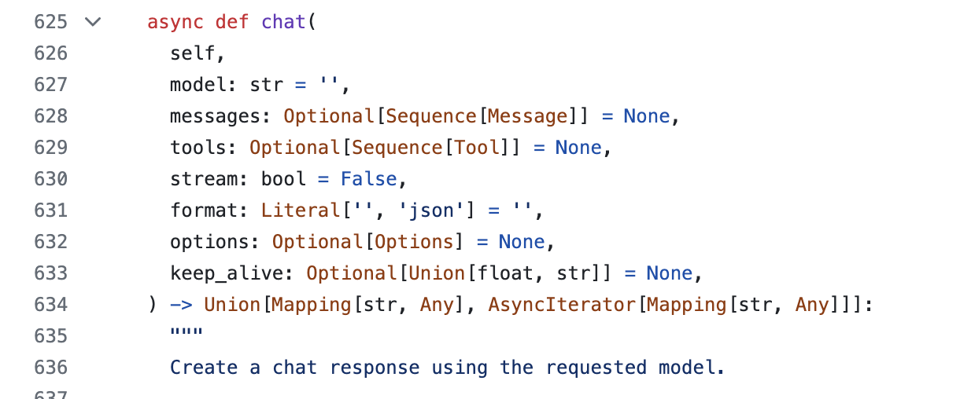
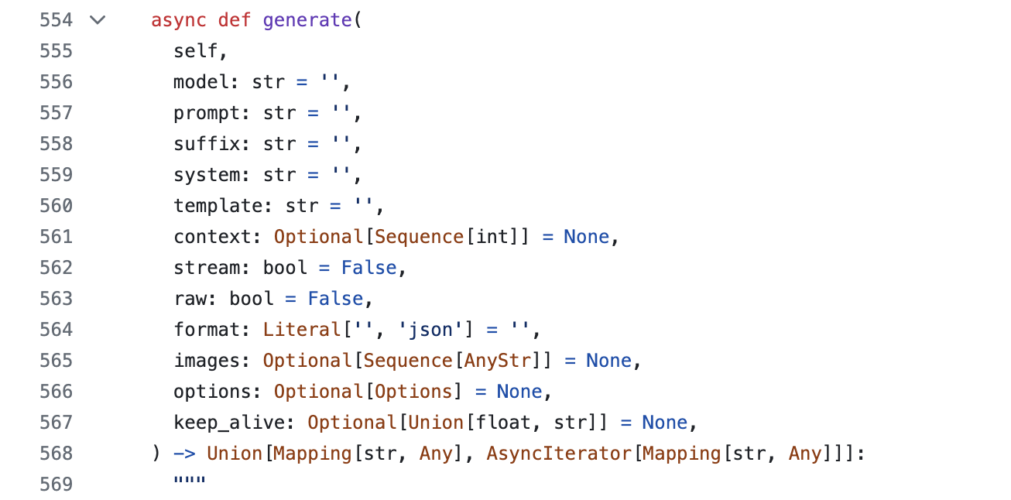
Ollama API
python API
pip install ollama

Slide 6
Ollama API
python API
pip install ollama
__all__ = [
...
'generate',
'chat',
'embed',
'embeddings',
'pull',
'push',
'create',
'delete',
'list',
'copy',
'show',
'ps',
]

Slide 7
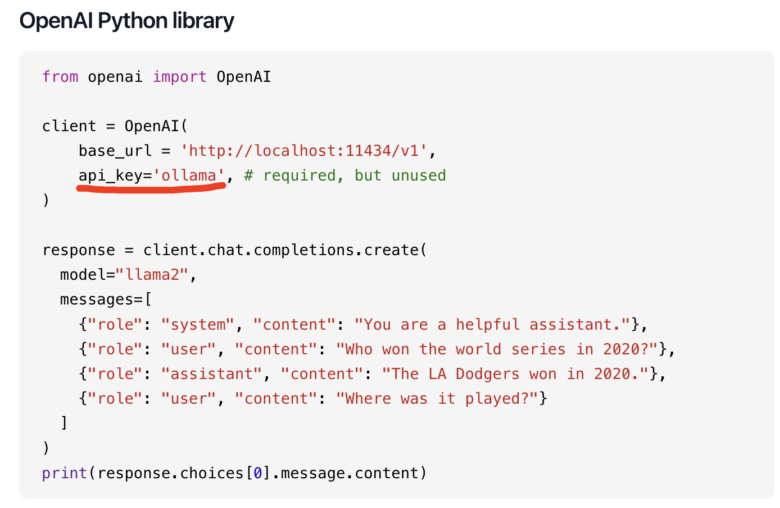
Ollama API
python API
pip install ollama
OpenAI Python library
https://ollama.com/blog/openai-compatibility

Slide 8
Ollama API
python API
pip install ollama
OpenAI Python library
https://ollama.com/blog/openai-compatibility
tools
https://github.com/ollama/ollama-python/blob/main/examples/tools/main.py

Slide 10
社区工具集成
https://github.com/ollama/ollama?tab=readme-ov-file#community-integrations

Slide 11
THANK YOU

